Slide 2
GANs
Latent code
Asymptotically consistent
No Markov chains needs
Often regarded as producing the best samples
No good way to quantify this

Slide 3

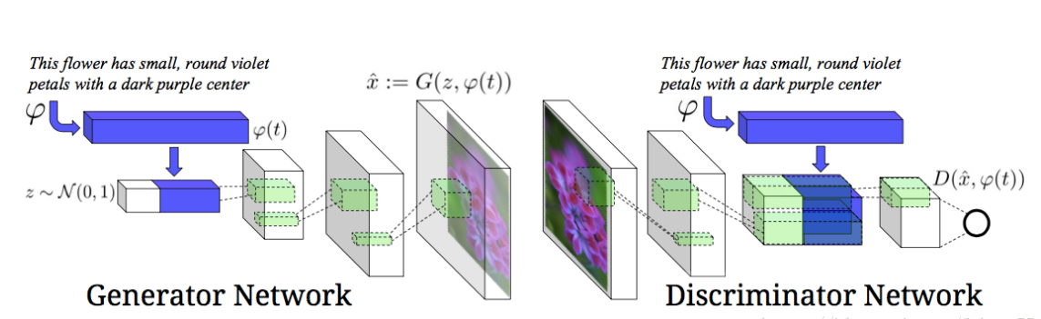
Adversarial net

Slide 4
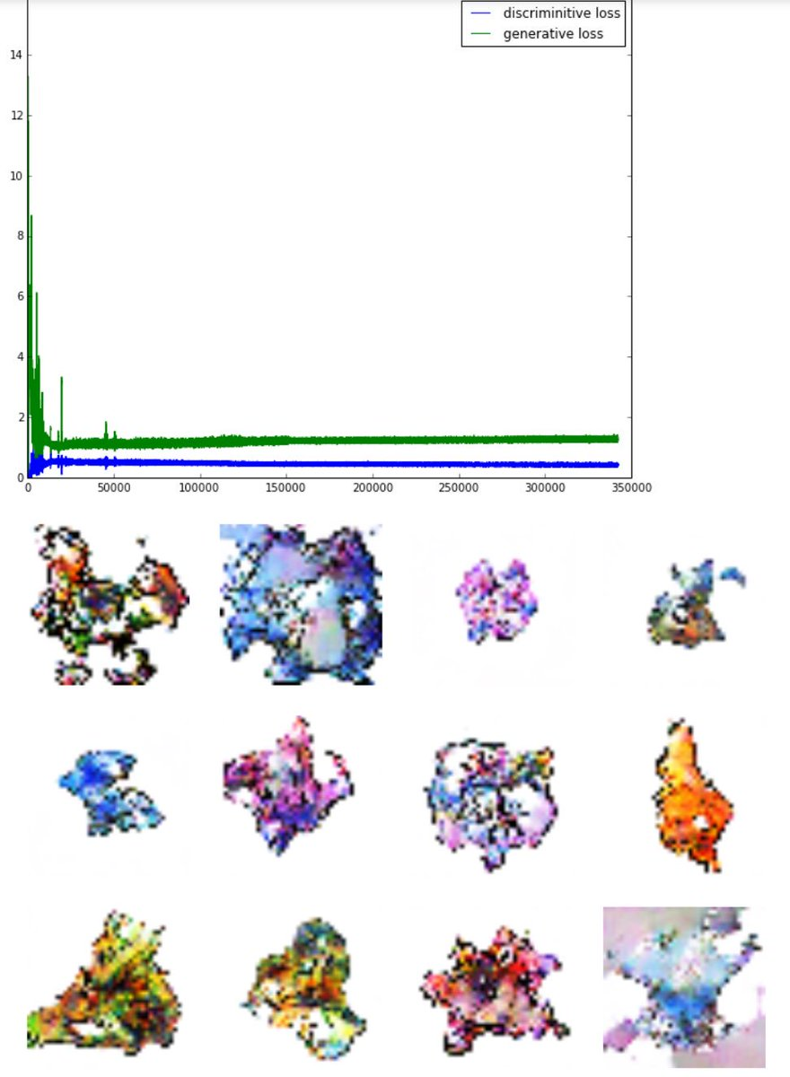
App
https://github.com/Zhenye-Na/pokemon-gan
Notes:
1. An interesting application of the generative pokemon, the left picture is after 1550 Epochs result
The blue line is discriminative loss
The green line is the generative loss.

Slide 5
Application

Slide 6
Adversarial net

Slide 7
Experiments
Training data set:
MNIST
Toronto Face Database (TFD)
CIFAR-10
Notes:
Training dataset :
The generator nets used a mixture of rectifier linear activations and sigmoid activations
The discriminator net used maxout activations,

